Slide 2
Build a managed analytics platform for your ecommerce business
boa309
Rohini Gaonkar
Suman Debnath
Sr. Developer Advocate
Amazon Web Services
Principal Developer Advocate
Amazon Web Services

Slide 3
Shopping, shopping, and more shopping!

Slide 4


Shopping, shopping, and more shopping!
End user standpoint
Good deals
Quality products
Useful recommendations
Competitive price

Slide 5




Shopping, shopping, and more shopping!
Organization standpoint

Slide 6
Analytics platform for an ecommerce store

Slide 7
Analytics platform for an ecommerce store
Brand’s popularity
Know in which brands you need to invest more marketing

Slide 8
Analytics platform for an ecommerce store
Brand’s popularity
Know in which brands I need to invest more marketing
User’s journey
Why do users add products to their carts after 11:00 PM but not buy them?

Slide 9
Analytics platform for an ecommerce store
Brand’s popularity
Know in which brands I need to invest more marketing
User’s journey
Why after 11 pm, the users add products to their carts, but don’t buy them in the end
Know your customers
Unique visitors per day
Top categories per hour or weekday

Slide 10
It’s all about time!
Data loses value quickly over time

Slide 11
It’s all about time!
Data loses value quickly over time
Value of data in decision-making
Real time

Slide 12

It’s all about time!
Data loses value quickly over time
“ONLINE” time-critical decisions
Data scientists
Value of data in decision-making
Preventive/predictive
Actionable
Real time
Seconds

Slide 13

It’s all about time!
Data loses value quickly over time
“ONLINE” time-critical decisions
Data scientists
“BATCH” business intelligence
Value of data in decision-making
Preventive/predictive
Business analysts
Actionable
Reactive
Business insights
Real time
Seconds
Minutes
Hours
Days
Months

Slide 14
What are we building in the next 40 minutes?

Slide 15

What are we building in the next 40 minutes?
End-to-end data engineering pipeline
Simulate the ecommerce workload
Open source dataset from REES46

Slide 16



What are we building in the next 40 minutes?
End-to-end data engineering pipeline
Simulate the eCommerce workload
Open Source dataset from REES46
Online processing
DDoS attack (fraudulent transactions)
System alerting and notification

Slide 17



What are we building in the next 40 minutes?
End-to-end data engineering pipeline
Simulate the eCommerce workload
Open Source dataset from REES46
Online processing
DDoS Attack (fraudulent transactions)
System alerting and notification
Batch processing
Top/bottom selling products
Dashboarding for business insights
Identify new product category

Slide 18
Data engineering architecture

Slide 19

Data engineering architecture

Slide 20
Data engineering architecture

Slide 21

Data engineering architecture
Amazon Kinesis Data Streams
ONLINE processing

Slide 22

Data engineering architecture
Amazon Kinesis Data Streams
Amazon Kinesis Data Analytics
ONLINE processing

Slide 23


Data engineering architecture
Apache Flink
Amazon Kinesis Data Streams
Amazon Kinesis Data Analytics
Amazon Kinesis Data Streams
AWS Glue
ONLINE processing

Slide 24


Data engineering architecture
Apache Flink
Amazon Kinesis Data Streams
Amazon Kinesis Data Analytics
Amazon Kinesis Data Streams
AWS Lambda
AWS Glue
ONLINE processing

Slide 25


Data engineering architecture
Apache Flink
Amazon Kinesis Data Streams
Amazon Kinesis Data Analytics
Amazon Kinesis Data Streams
AWS Lambda
Amazon DynamoDB
Amazon SNS
AWS Glue
ONLINE processing
ONLINE processing

Slide 26

Data engineering architecture
Apache Flink
Amazon Kinesis Data Streams
Amazon Kinesis Data Analytics
Amazon Kinesis Data Streams
AWS Lambda
Amazon DynamoDB
Amazon SNS
AWS Glue
BATCH processing

Slide 27
Data engineering architecture
Apache Flink
Amazon Kinesis Data Streams
Amazon Kinesis Data Analytics
Amazon Kinesis Data Streams
AWS Lambda
Amazon DynamoDB
Amazon SNS
AWS Glue
BATCH processing

Slide 28

Data engineering architecture
Apache Flink
Amazon Kinesis Data Streams
Amazon Kinesis Data Analytics
Amazon Kinesis Data Streams
AWS Lambda
Amazon DynamoDB
Amazon SNS
AWS Glue
Amazon Kinesis Data Firehose
BATCH processing

Slide 29

Data engineering architecture
Apache Flink
Amazon Kinesis Data Streams
Amazon Kinesis Data Analytics
Amazon Kinesis Data Streams
AWS Lambda
Amazon DynamoDB
Amazon SNS
AWS Glue
Amazon Kinesis Data Firehose
Amazon S3
BATCH processing

Slide 30

Data engineering architecture
Apache Flink
Amazon Kinesis Data Streams
Amazon Kinesis Data Analytics
Amazon Kinesis Data Streams
AWS Lambda
Amazon DynamoDB
Amazon SNS
AWS Glue
Amazon Kinesis Data Firehose
Amazon S3
BATCH processing

Slide 31


Data engineering architecture
Apache Flink
Amazon Kinesis Data Streams
Amazon Kinesis Data Analytics
Amazon Kinesis Data Streams
AWS Lambda
Amazon DynamoDB
Amazon SNS
AWS Glue
Amazon Athena
Amazon QuickSight
Amazon Kinesis Data Firehose
Amazon S3
BATCH processing

Slide 32


Demo
https://github.com/debnsuma/boa309

Slide 33
Ecommerce workload simulation
Apache Flink
Amazon Kinesis Data Streams
Amazon Kinesis Data Analytics
Amazon Kinesis Data Streams
AWS Lambda
Amazon DynamoDB
Amazon SNS
AWS Glue
Amazon Athena
Amazon QuickSight
Amazon Kinesis Data Firehose
Amazon S3

Slide 34
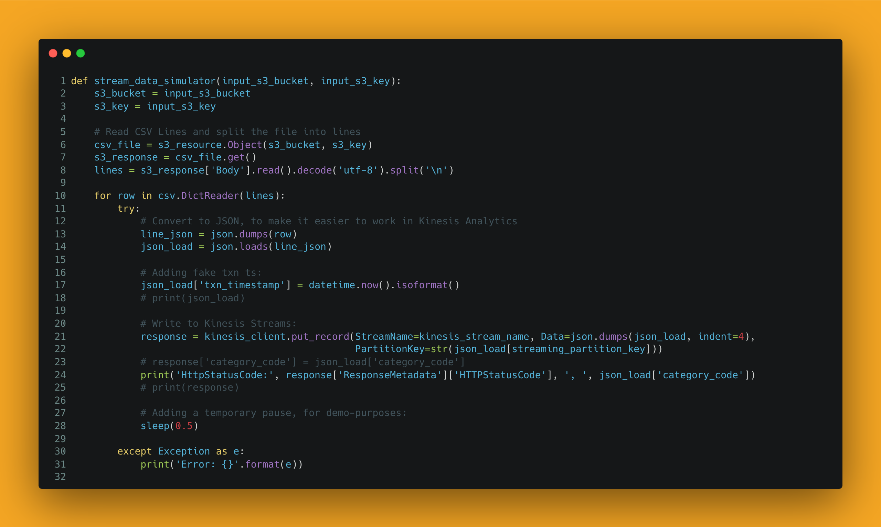
Ecommerce workload simulation

Slide 35


Ecommerce workload simulation
AWS Cloud9
Amazon S3

Slide 36
Ecommerce workload simulation
AWS Cloud9
Amazon S3

Slide 37
Ecommerce workload simulation
AWS Cloud9
Amazon Kinesis Data Streams
Amazon S3

Slide 38

Streaming application
Apache Flink
Amazon DynamoDB
AWS Cloud9
Amazon Kinesis Data Streams
Amazon Kinesis Data Analytics
Amazon Kinesis Data Streams
AWS Lambda
Amazon SNS
AWS Glue
Amazon Athena
Amazon CloudWatch
Amazon QuickSight
Amazon S3
Amazon Kinesis Data Firehose
Amazon S3
Notes:
Flink -> One of the top 5 projects of Apache Community
Apache Flink is a freamwork which is a distributed processing engine for stateful computations over unbounded and bounded data streams. You can use Python SQL Scala

Slide 39
Streaming application
Apache Flink
Amazon Kinesis Data Streams
Amazon Kinesis Data Analytics
Amazon Kinesis Data Streams
AWS Glue

Slide 40
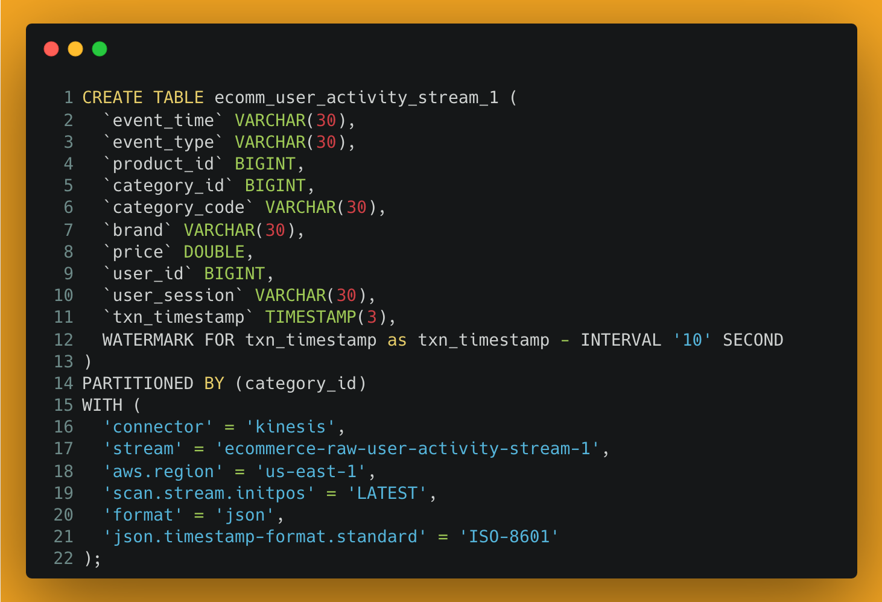
Streaming application
Apache Flink
Amazon Kinesis Data Streams
Amazon Kinesis Data Analytics
Amazon Kinesis Data Streams
AWS Glue

Slide 41
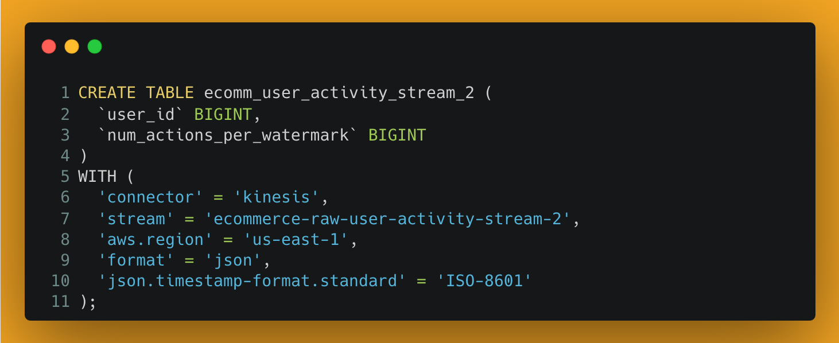
Streaming application
Apache Flink
Amazon Kinesis Data Streams
Amazon Kinesis Data Analytics
Amazon Kinesis Data Streams
AWS Glue

Slide 42
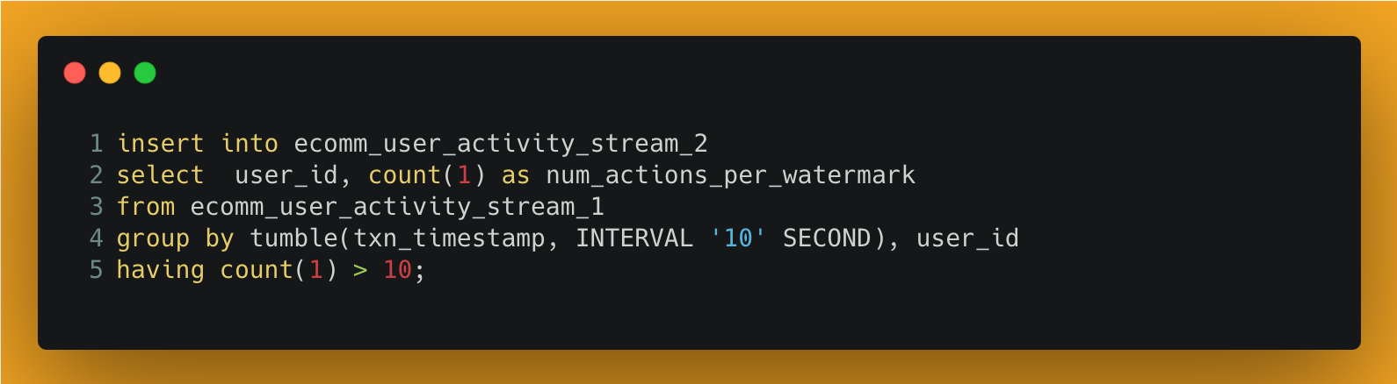
Streaming application
Apache Flink
Amazon Kinesis Data Streams
Amazon Kinesis Data Analytics
Amazon Kinesis Data Streams
AWS Glue

Slide 43


Rohini Gaonkar
Suman Debnath
in/rohinigaonkar/
@rohini_gaonkar
in/suman-d/
@_sumand

